Slide 1
How to Submit an EETP Application for EETP Applications

Slide 2
Course Overview
The purpose of this training program is to equip learners with a fundamental understanding of the ETA program including the components of the program, the EETP application process, and the loan management process.

Slide 3
Welcome
You will learn about the fundamentals of the Excellence in Teaching Act (ETA) and how to navigate the ETA online system.
This includes:
The purpose of the Excellence in Teaching Act
The components of the Excellence in Teaching Act Eligibility and application requirements
The ETA loan application process

Slide 4
What is the Excellence in Teaching Act (ETA)?
The Excellence in Teaching Act (ETA is a legislative bill passed in the state of Nebraska designed to attract new teachers and upskill existing teachers. It was created in April 2009 when the Nebraska Legislature approved LB547 and revised the Attracting Excellence to Teaching Program created in 2006 to become the Excellence in Teaching Act.
The ETA grants the Nebraska Coordinating Commission for Post-secondary Education (CCPE) and the State Board of Education the authority to set forth rules and regulations to carry out the Act. The ETA is comprised of three main components.

Slide 5
ETA Programs Overview
The Attracting Excellence in Teaching Program (AETP)
The Attracting Excellence in Teaching Program – Student Teaching (AETP - ST)
The Enhancing Excellence in Teaching (EETP - ST)
The purpose of the Attracting Excellence to Teaching Program is to:
Attract outstanding students to major in teacher shortage areas at the teacher education programs at Nebraska colleges and universities.
Retain resident students and graduates as teachers in Nebraska schools; and
Establish a loan contract that requires a borrower to obtain employment as a Nebraska teacher upon graduation from a college or university.
The Attracting Excellence to Teaching - Student Teaching (AETP-ST) provides a one-time forgivable loan to eligible students who are enrolled in an undergraduate or graduate teacher education program at an eligible Nebraska institution working towards their initial certificates to teach in Nebraska during their student teaching semester.
The Enhancing Excellence in Teaching Program (EETP) provides forgivable loans to Nebraska teachers enrolled in an eligible graduate program at an eligible Nebraska institution.

Slide 6
Enhancing Excellence in Teaching Program (EETP) Overview
The Enhancing Excellence in Teaching Program (EETP) provides forgivable loans to Nebraska teachers enrolled in an eligible graduate program at an eligible Nebraska institution. It is part of the Excellence in Teaching Act passed by the Nebraska Legislature and signed into law on April 22, 2009.

Slide 7
EETP Eligibility
An applicant must meet the following criteria to be considered for EETP funds:
Be a certificated teacher employed at least half-time (0.50 FTE) to teach in an approved or accredited PK-12 school in Nebraska;
Be enrolled at an eligible Nebraska institution in an eligible graduate program (a program of study leading to a graduate degree or a graduate course of study leading to an added endorsement in a shortage area);
The graduate program leads to: 1. A degree or added endorsement in a shortage area, or 2. A degree in curriculum and instruction, or 3. A degree in a subject area in which a secular teaching endorsement is already held*, or 4. A degree in a subject area that will result in an additional secular teaching endorsement not considered a shortage area which the superintendent of the school district or head administrator of a nonpublic school believes will be beneficial to the students of the school district or school;
Be a resident Nebraska student; Agree to complete the degree or endorsement program on which eligibility for EETP funds was based; and
Commit to teach full-time in an accredited or approved public or private PK-12 school in Nebraska upon successful completion of the eligible graduate program for a time-period equal to the number of years required for loan forgiveness.

Slide 8
How Does the EETP Work?
The Excellence in Teaching Act (ETA) is a legislative bill passed in the state of Nebraska designed to attract new teachers and upskill existing teachers. It was created in April 2009 when the Nebraska Legislature approved LB547 and revised the Attracting Excellence to Teaching Program created in 2006 to become the Excellence in Teaching Act.
The ETA grants the Nebraska Coordinating Commission for Post-secondary Education (CCPE) and the State Board of Education the authority to set forth rules and regulations to carry out the Act. The ETA is comprised of three main components.

Slide 9
EETP Loan Forgiveness Obligation
The borrower must successfully complete the eligible graduate program for which the funds were received and maintain certification and employment as a full-time teacher in Nebraska for a time-period equal to the number of years required for loan forgiveness.
At the end of the third consecutive year of teaching full-time in Nebraska following completion of the eligible graduate program, the combined total of any EETP funds received will be forgiven in an amount of up to $1,500.
Beginning with the fourth consecutive year of teaching full-time in Nebraska following completion of the eligible graduate program:
For each additional year the borrower teaches full-time in a school NOT classified as a low-income school or very sparse district, the combined total of any EETP funds received will be forgiven in an amount of up to $1,500.
For each additional year the borrower teaches full-time in a local school system classified as very sparse or in a school building that meets the high poverty guidelines (low-income school) established by NDE in the year(s) in which loan forgiveness commences, the combined total of any EETP funds received would be forgiven in an amount up to $3,000.

Slide 10
If the recipient does not meet the loan forgiveness obligations described above, then the loan must be repaid, with interest accruing as of the date the borrower signed the contract.

Slide 11
EETP Application Process Overview
Roles and Responsibilities

Slide 12
 | Applicant/Recipient An applicant's primary role within the ETA application process is to create and submit applications. Once an application is submitted and approved, the applicant is converted into a Recipient. Within the ETA system, an Applicant/Recipient can: Registers as a new user Submits applications Receives notifications and updates on application, loan payment, loan repayment statuses Uploads supporting documentation Signs loan contracts Submits ACH info for loan repayment

Slide 13
 | IHE Coordinator Institution of Higher Education (IHE Coordinators play a supporting role in ETA applications. They represent the Applicant's college or university and are the first line of approval for all applications. Additionally, they can also upload supporting documentation for an application such as a GPA supplement, program of study information, and residency verification. Within the ETA system, an IHE Coordinators can: Within the ETA system, an Applicant/Recipient can: Registers as a new user Register as a new user Review and approve/deny applications Upload documentation

Slide 14
 | ETA Specialist An ETA Specialist's primary role is to manage applications within the ETA system. This includes approving and denying applications, generating loan contracts, and flagging applications. ETA Specialists are also responsible for assessing program eligibility and for determining eligible loan amounts. Within the ETA system, an ETA Specialist can: Register as a new user Review and approve/deny applications Mark approved applications to be paid by Accounting Mark loans to be forgiven and loans to begin repayment Create and sign loan contracts Mark loans as repaid

Slide 15
EETP Application Process Overview
Application Flow

Slide 16
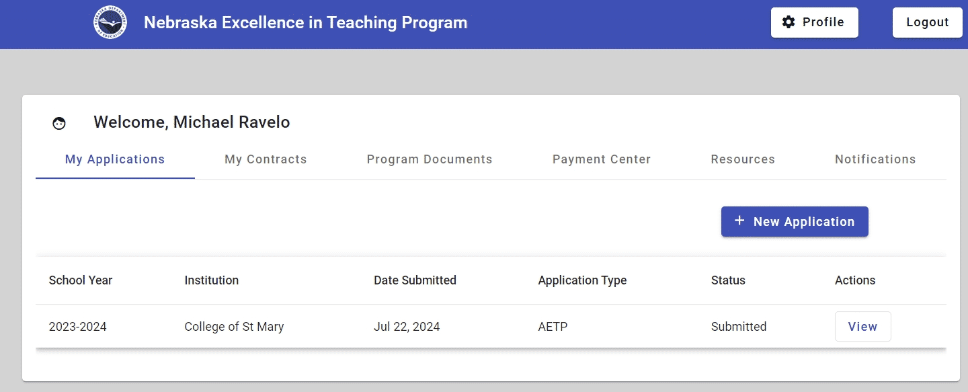
Step 1 – Application Submission
The application process begins when an Applicant submits a new application. The application is captured in ETA system and becomes available for review by IHE Coordinators and ETA Specialists.

Slide 17
Step 2 – IHE Review
After an application is submitted, it is reviewed by the IHE coordinator representing the Applicant's Institution of Higher Education. The IHE coordinator performs basic verification of the Applicant's:
State residency
Enrollment status
Program of study
If the IHE coordinator denies the application, it is routed back to the Applicant.

Slide 18
Step 3 – ETA Specialist Review
Applications approved by the IHE Coordinator are routed to an ETA Specialist who reviews the Applicant's program eligibility and determines loan award amounts.
Applications that are denied are routed back to the Applicant.

Slide 19
Step 4 – Contract Generation
Once the application is approved by the IHE Coordinator and the ETA Specialist, the ETA Specialist generates loan contract documents which are routed back to the applicant.

Slide 20
Step 5 – Applicant Signs Contract
The Applicant receives a notification that their contract documents are ready for signature. Once the Applicant signs the documents, they are routed back to the ETA Specialist for countersignature.

Slide 21
Step 6 – ETA Specialist Countersigns the Contract
The contract signed by the Applicant is routed back to the ETA Specialist for signature.

Slide 22
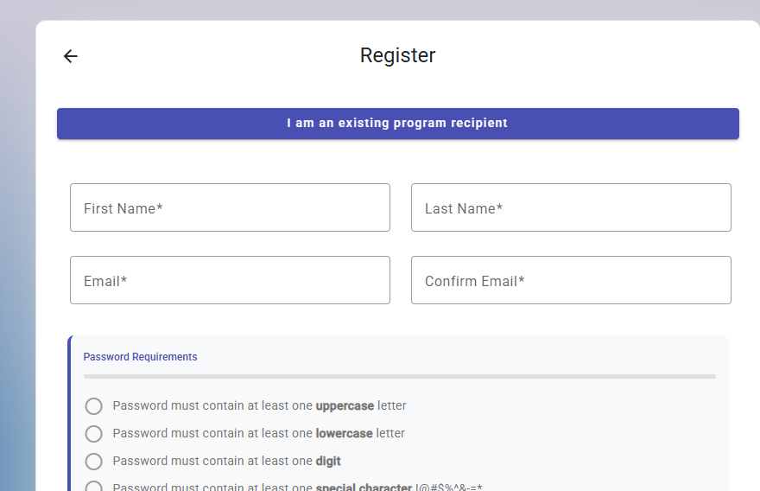
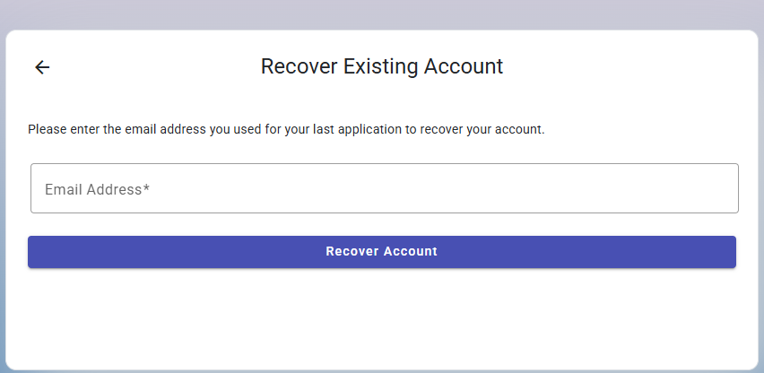
Registering for an ETA account:
If you are a past recipient of any of the three ETA forgivable loan programs: EETP, AETP, or AETP-Student Teaching, you will need to first select “I am an existing program recipient”. This is will prompt you to enter you email address. This is how you will register for you ETA account.

Slide 23
Registering an ETA Account
Accessing the ETA Application
To get started, users should enter https://eta.education.ne.gov/login into their browser.
The ETA application supports modern browsers such as:
Microsoft Edge
Google Chrome
Mozilla Firefox
Watch the video tutorial for more information on creating an ETA Account.

